Slide 1
Jet Racer Soccer League with Advanced Sensor Suite
Arjun Simha, Casey Rittenhouse, Cooper Ritter, K Gupta, Julie Ham, Mason Kang, Jarod Marshel
Notes:
Jarod

Slide 2
Problem Statement
This project aims to develop artificially intelligent agents using four JetRacer cars to compete in a 2v2 soccer environment. This year we were tasked to implement a new sensor to improve this soccer play.
Deliverables: videos demonstrating basic movement, image recognition, and cooperative/competitive capabilities, open-source guide for agent recreation, transportable soccer arena.
Deep Soccer Simulation
2v2 Soccer
Object Detection
Object Following
Basic Motion
New Sensor
Notes:
Arjun

Slide 3
Previous Capstone Progress
Built and gained basic motion of 4 JetRacer cars.
Implemented object detection model that identifies a soccer ball, opponent, and goal.
Implemented software to follow a ball.
Started on Unity simulation to train agents to compete in a 2v2 soccer match.
Created a GitHub page documenting instructions to setup JetRacer cars.
Notes:
Jarod

Slide 4
Implementation
Cars are based on an RC car with throttle and steering control.
A MUX is used to select between remote and software control
Jetson Nano performs CV to determine ball distance and position
Car steers towards ball and strikes it in the desired direction
To efficiently divide tasks, the team split into 4 sub-groups: Sensor, Computer Vision, ROS, Unity
Notes:
Arjun

Slide 5
Implementation
We used a combination of the following hardware and software tools:
PyTorch
YOLOv8
Unity
Nvidia Jetson Nano
Zed2 Stereo Camera
YDLiDAR X4
Servo Motor
Python
ROS Melodic/Noetic
Tamaya RC Cars
Motor Drivers
Arduino (for testing)
Notes:
Jarod

Slide 6
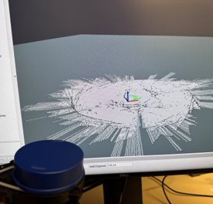
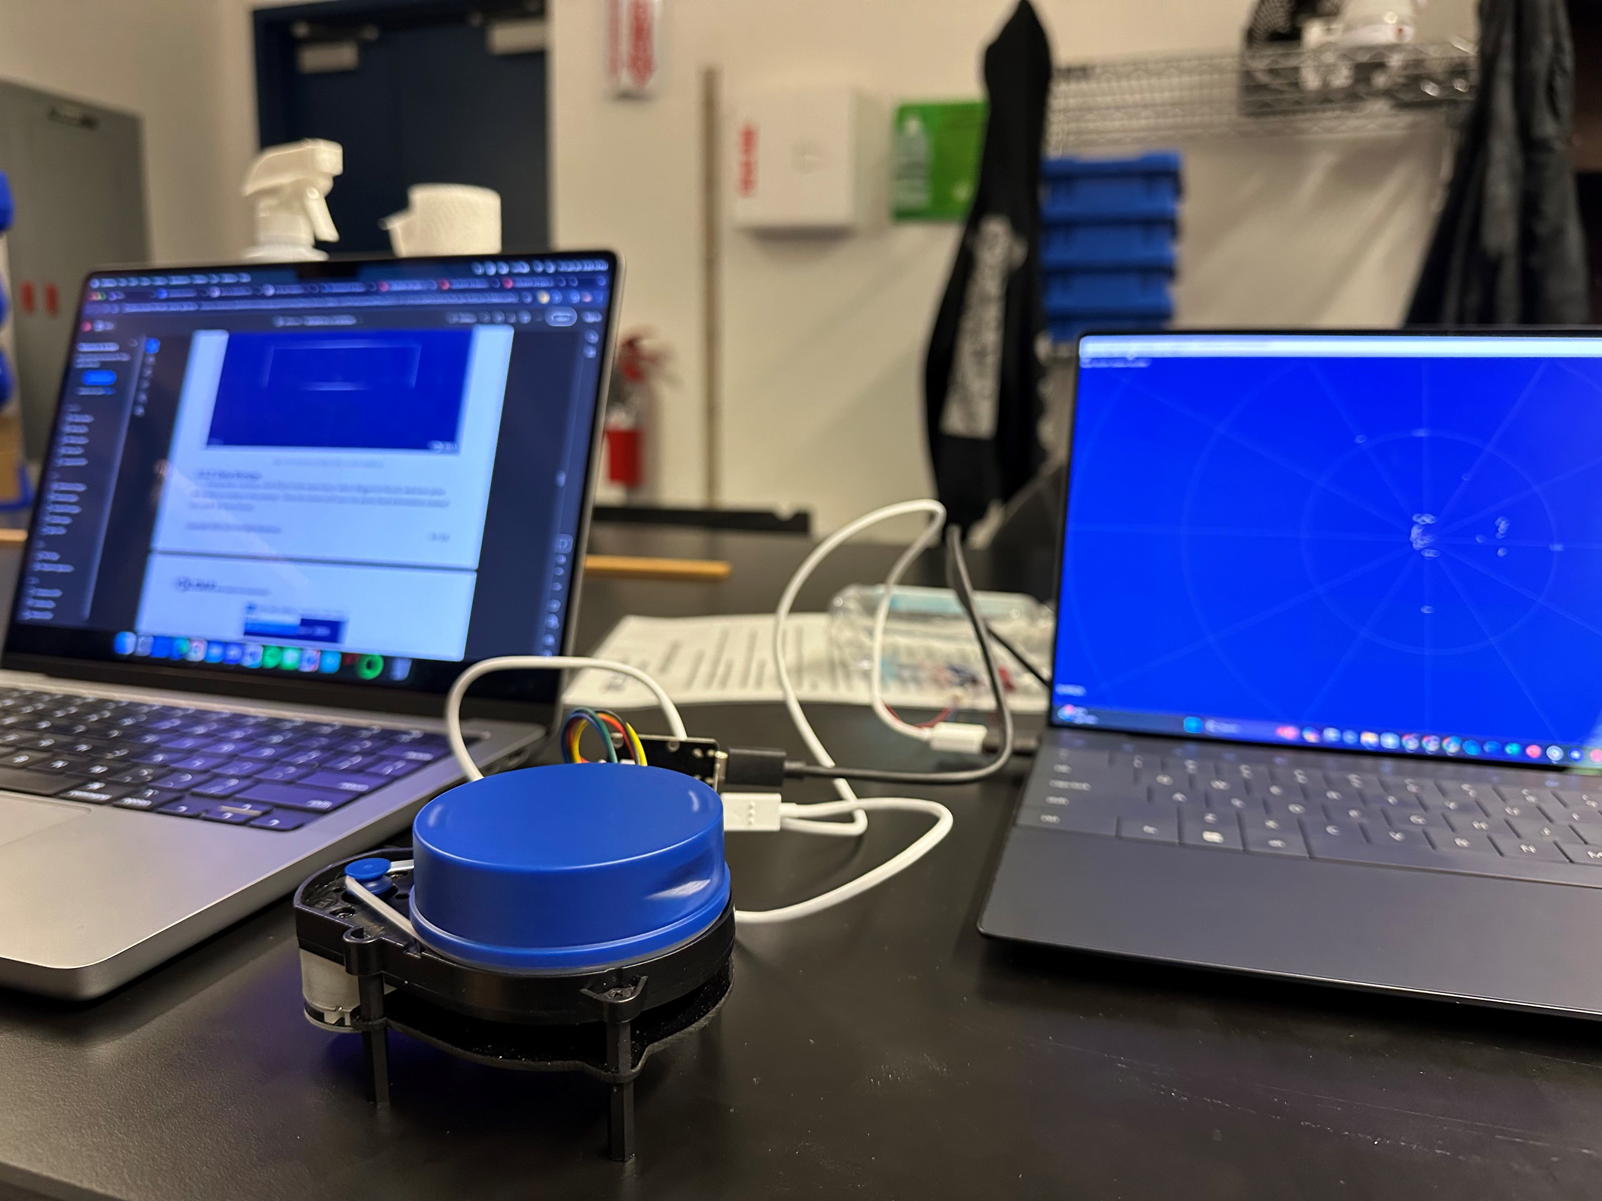
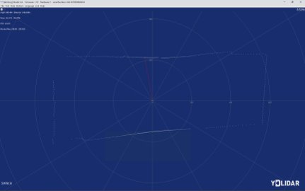
Sensors – LiDAR
We performed initial sensor testing with the YD LiDAR X4.
Used RVIZ to evaluate qualitative performance.
Pros – Relatively low cost, worked with ROS, integrated into Hector SLAM
Cons – Not enough points, low frequency refresh rate, hard to mount, don't have odometry data for proper SLAM, couldn't see ball
Notes:
Jarod

Slide 7
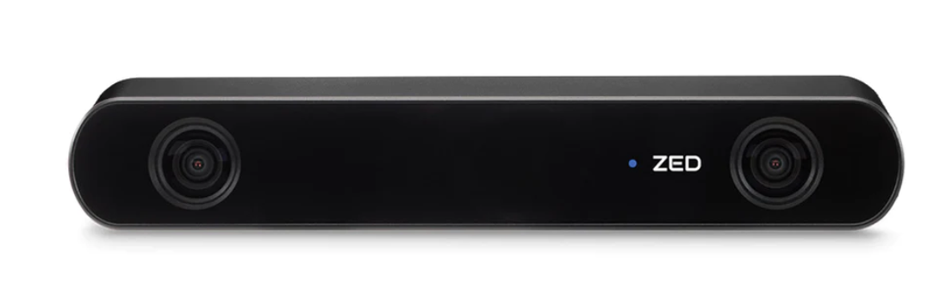
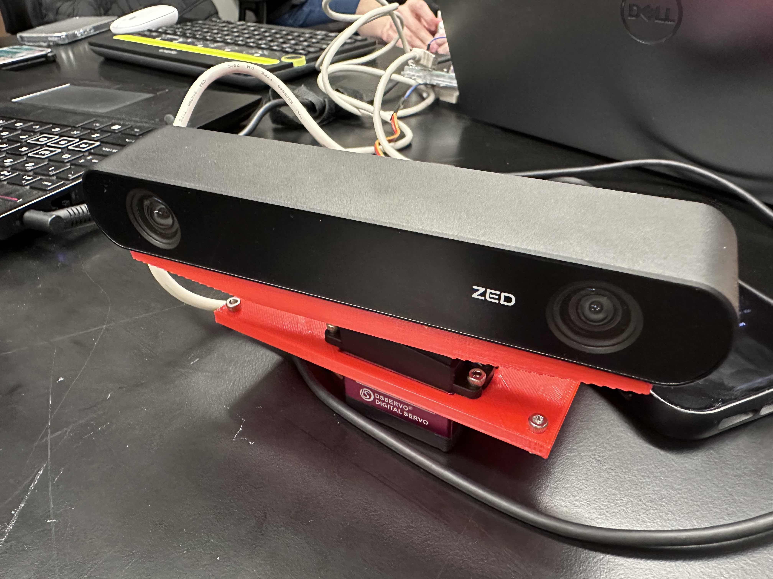
Sensors – AI Stereo Camera
Started testing the Zed camera with the YoloV8 and the COCO dataset to find the sport ball and track it.
We use a servo motor to turn the zed camera on the X-axis to look around and find the soccer ball on the field.
Future work: continue to work on making the object detection smoother for the zed camera and the CV system.
Find a more stable power source to run the Jetson and the Zed camera at the same time.
Looking into upgrading to the Jetson Orin Nano to get better framerate on the Zed.
Notes:
K

Slide 8
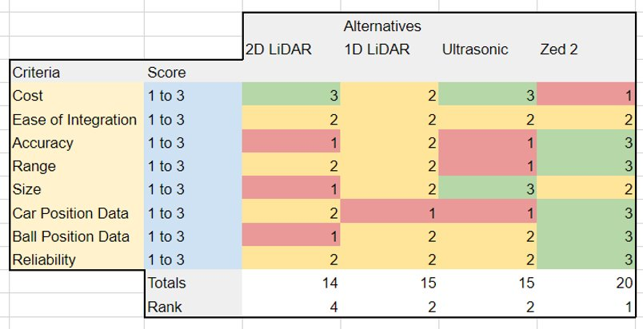
Sensor Trade Study
We performed a trade study weighing the pros and cons of different sensors
Overall, we found that the Zed 2 sensor had more pros than cons.
The only con for the Zed 2 is the cost, however we have the budget to purchase them.
Notes:
K

Slide 9
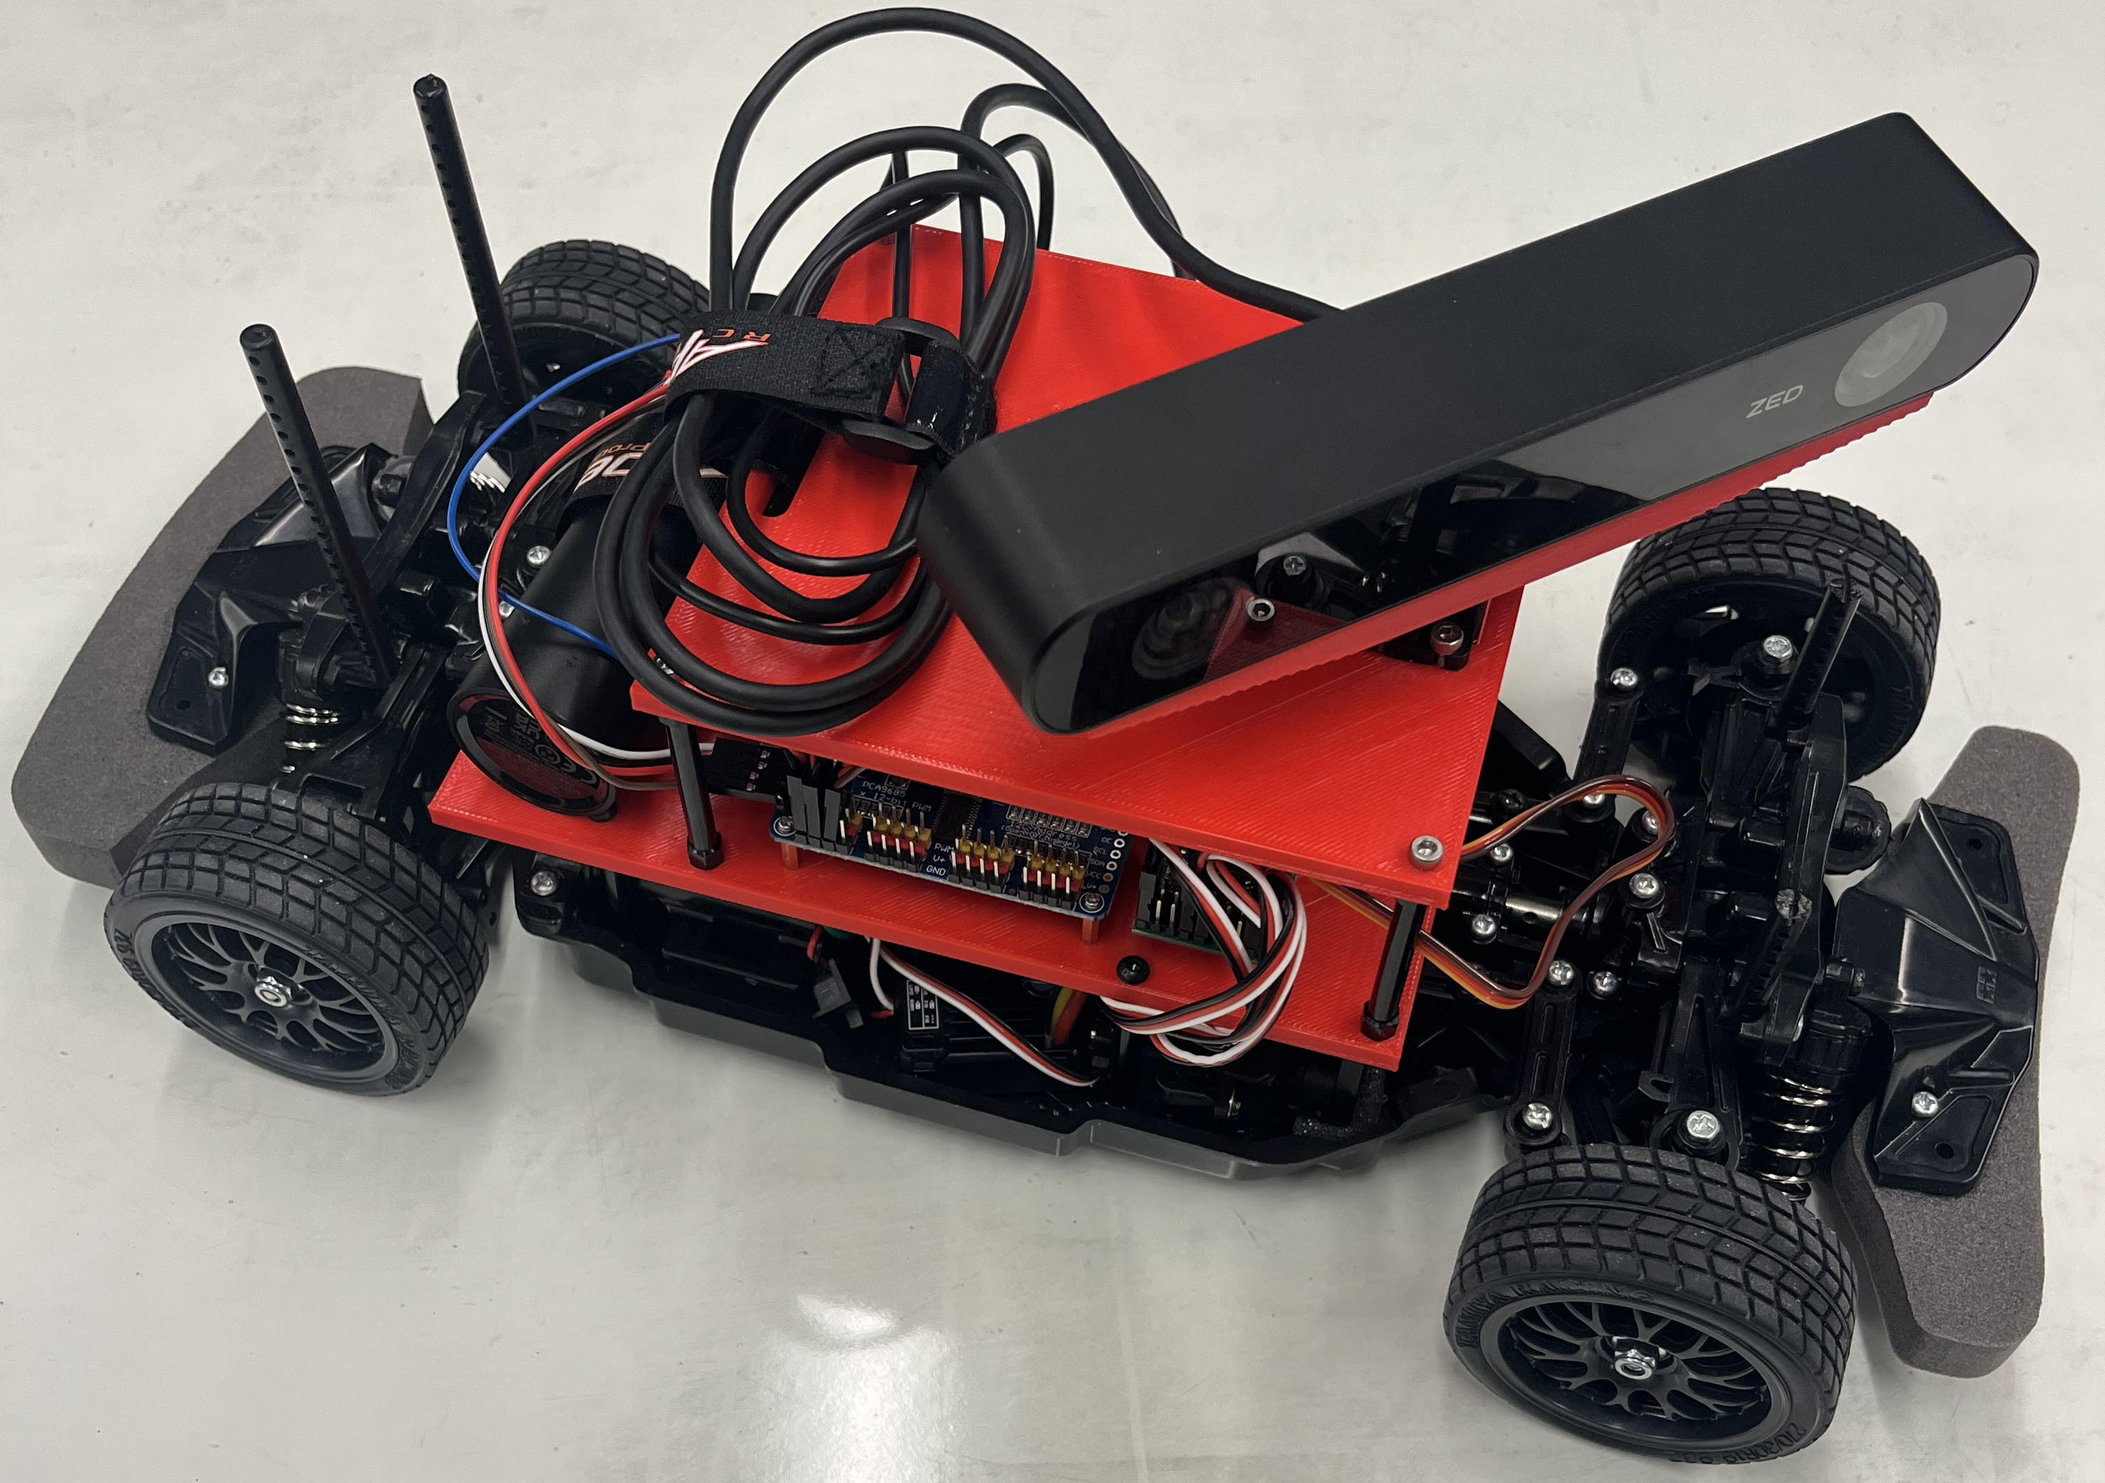
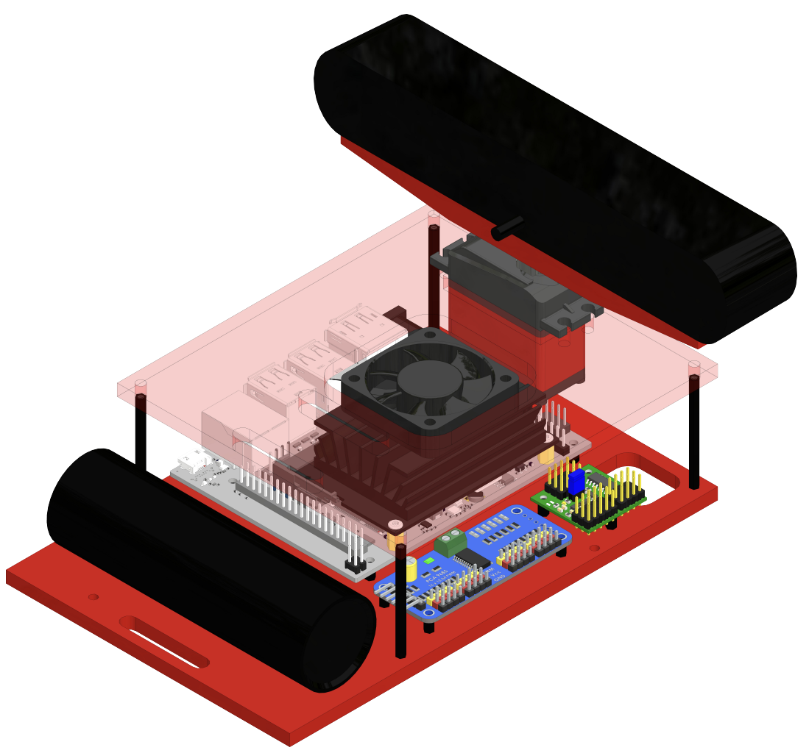
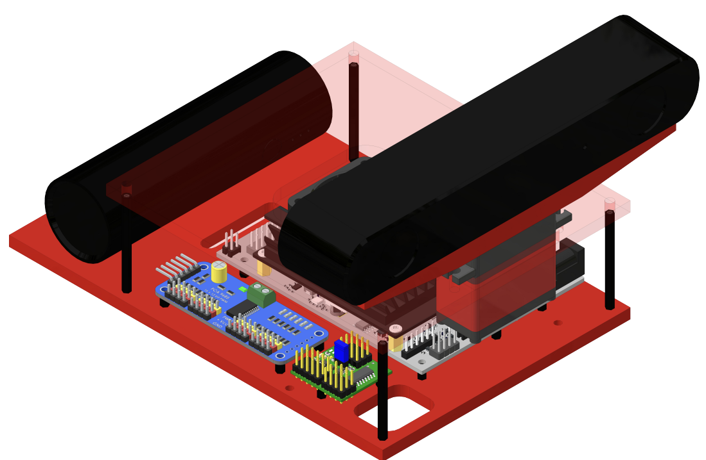
RC Mechanical Design
Designed new 3D printed chassis, servo mount, and ZED2 mount.
Red and blue filament to aid CV.
Mounted electronics using M2 hex standoffs instead of double-sided tape.
Notes:
Cooper

Slide 10
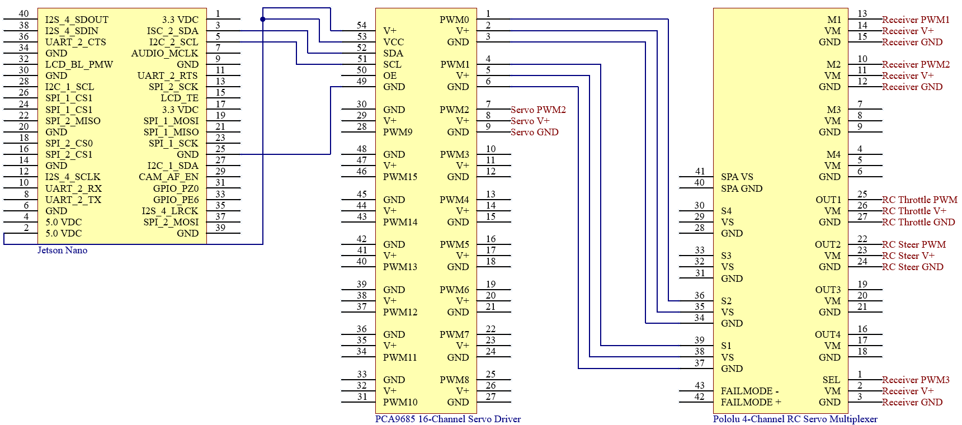
RC Electrical Design
Stock:
Adafruit 16-channel servo driver controls RC throttle (PWM 0) and RC steering (PWM 1).
4-Channel MUX switches between manual and software control.
Jetson Nano powered by 5V portable power bank, motors by 12V NiMH battery pack.
Changes
Servo driver PWM2 used to control camera servo, increased to 5V logic and V+.
ZED2 connected by USB.
Notes:
Cooper

Slide 11
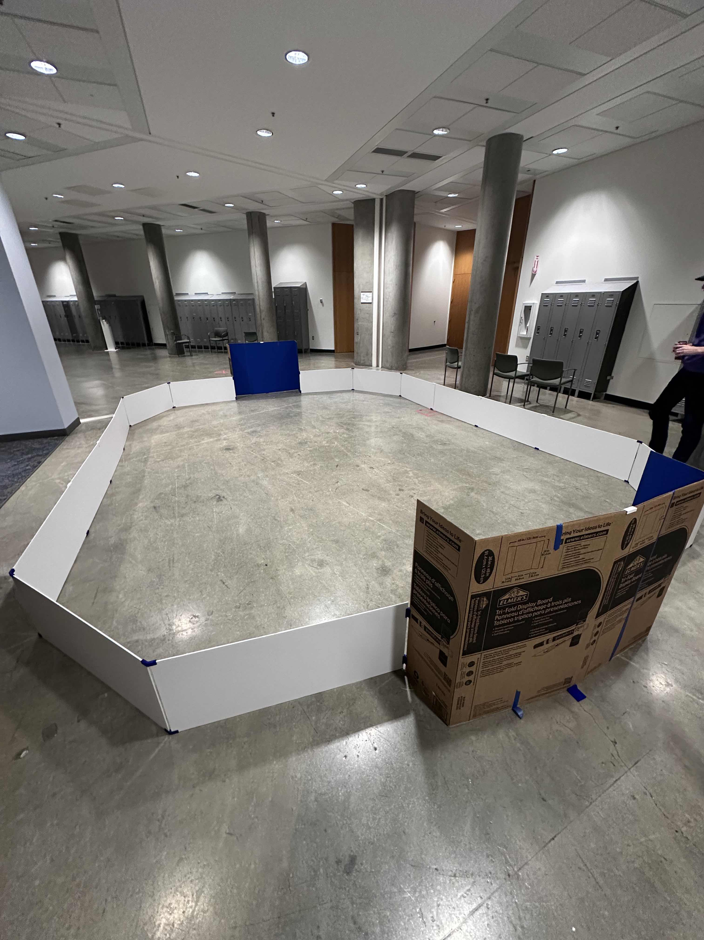
Field
We constructed a new field for the JetRacer cars to play soccer inside of, using foam poster board.
Printed 3D brackets for stands to hold up the walls and connect the walls to the goals on each side.
Future work: Going to abuse test the field with the cars and the soccer ball running into the walls.
Test the ZED camera's depth sensing and CV in the field to make sure the white walls work well with our sensors.
Notes:
Julie

Slide 12
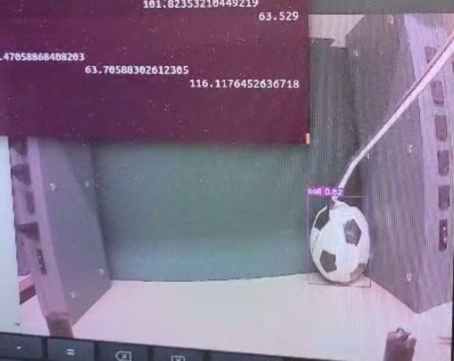
Computer Vision
Used previous team's YOLOv7 object detection
Implement object following from scratch:
Find x-offset from the center of the ball's bounding box to center of camera's FOV.
Pass that to ROS and the control servos to reduce offset to 0 through PID.
Ball bounding box
Notes:
Julie

Slide 13
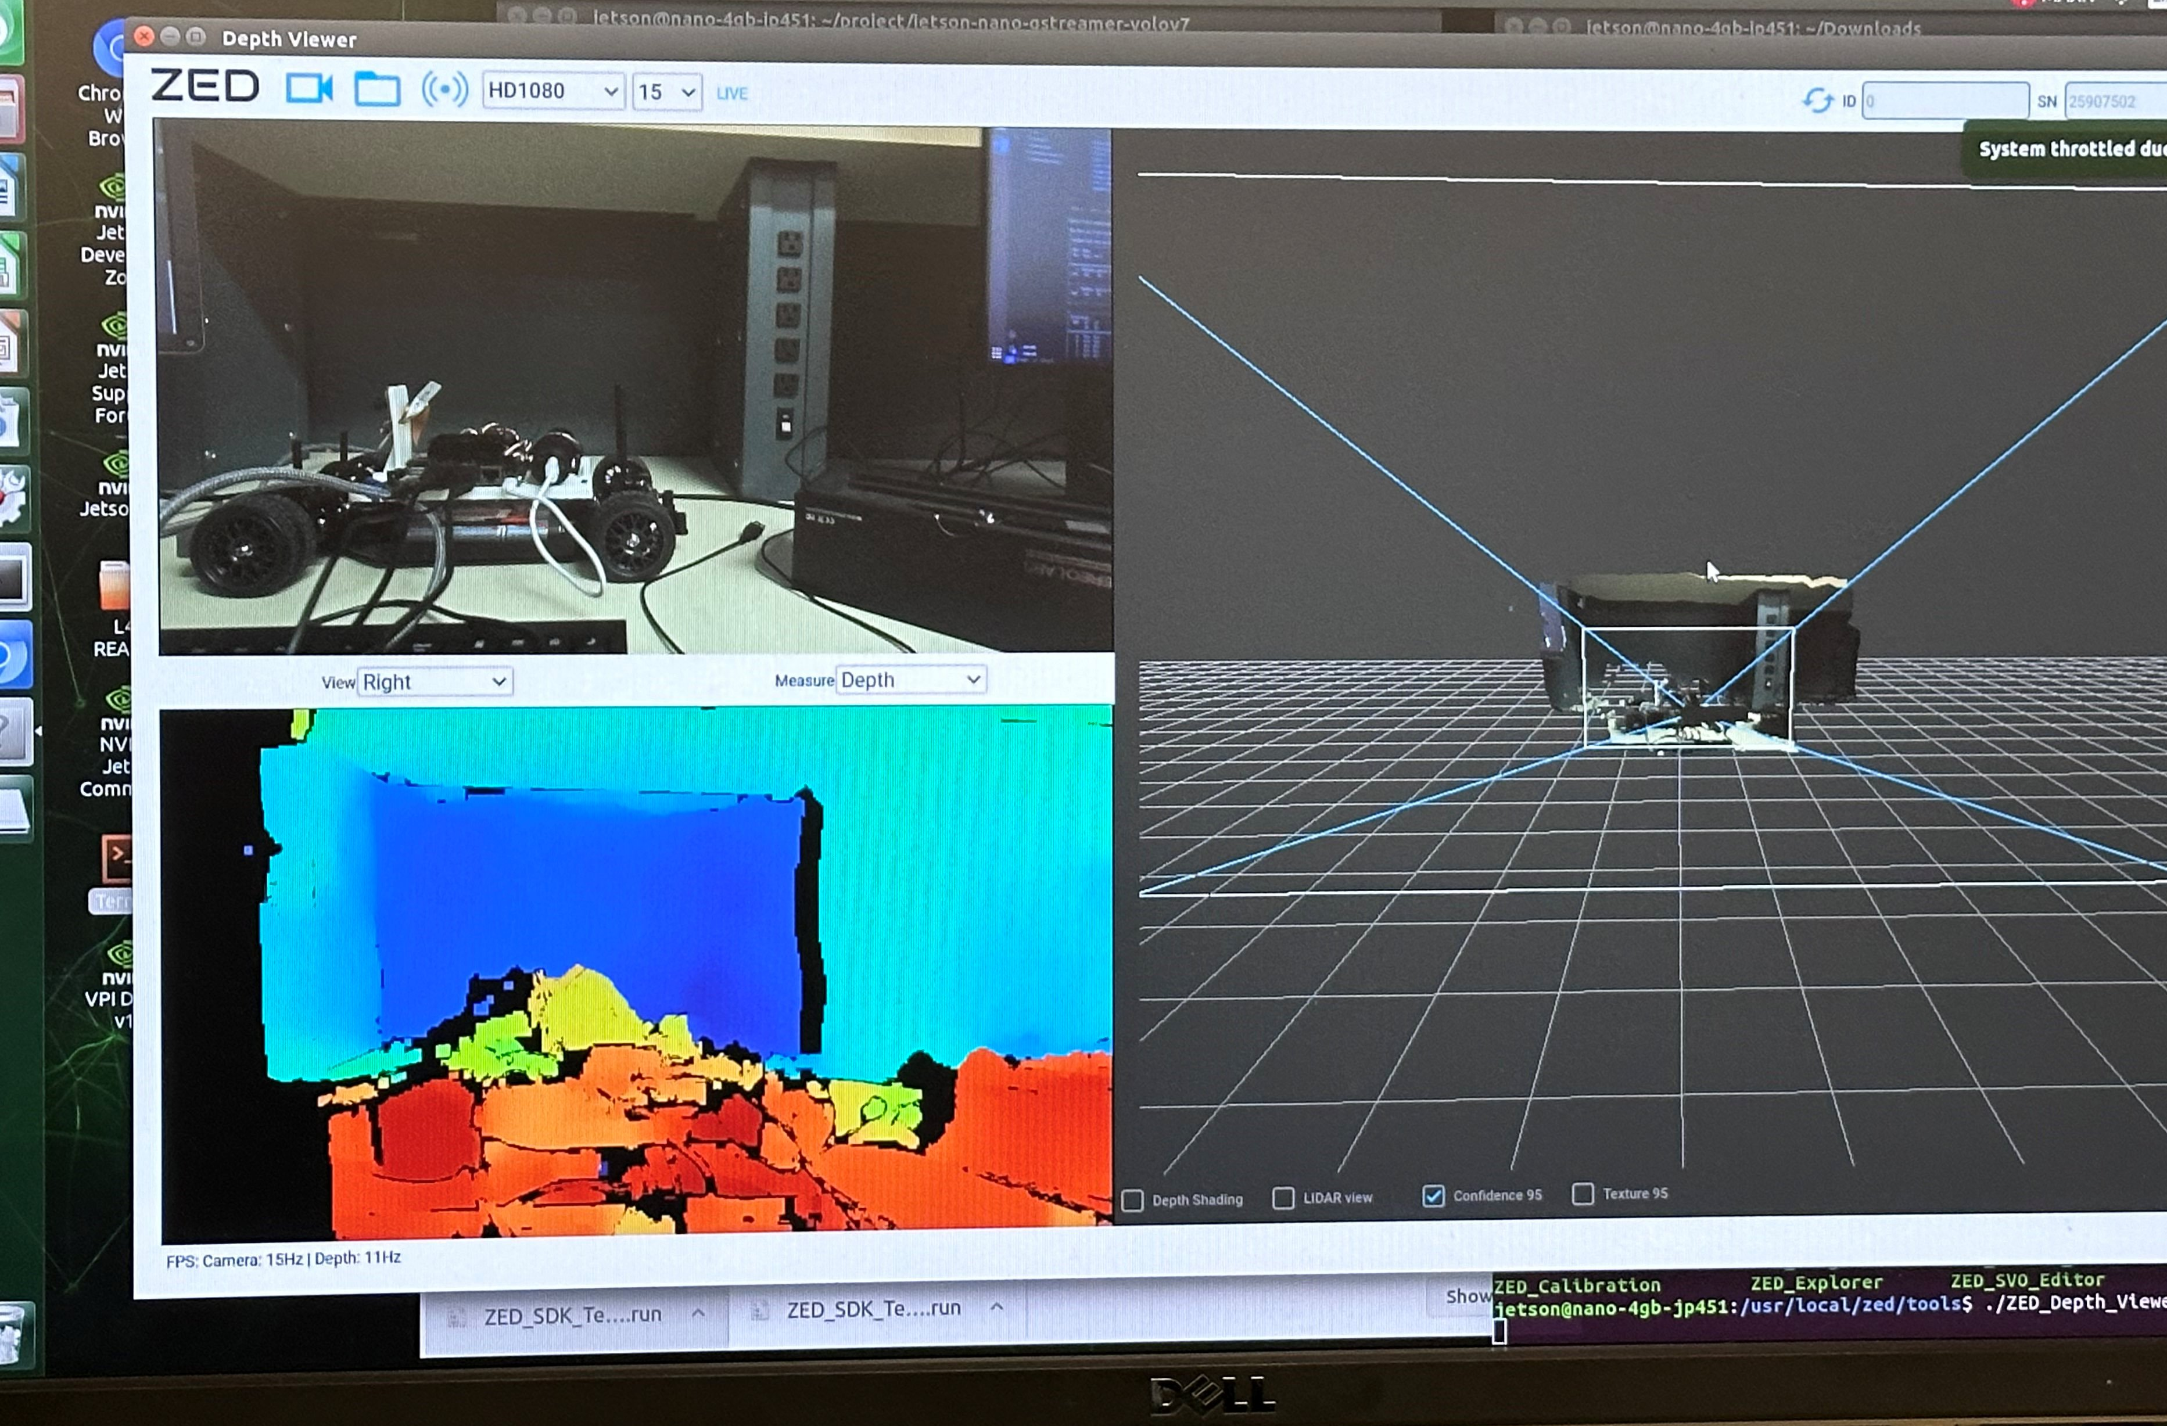
Computer Vision
New sensor: ZED2
Used ZED SDK's YOLOv8 object detection algorithm trained on COCO dataset
Detects sports ball through same object following method described on previous slide
Future work: create new dataset, improve current YOLO model
Notes:
K

Slide 14
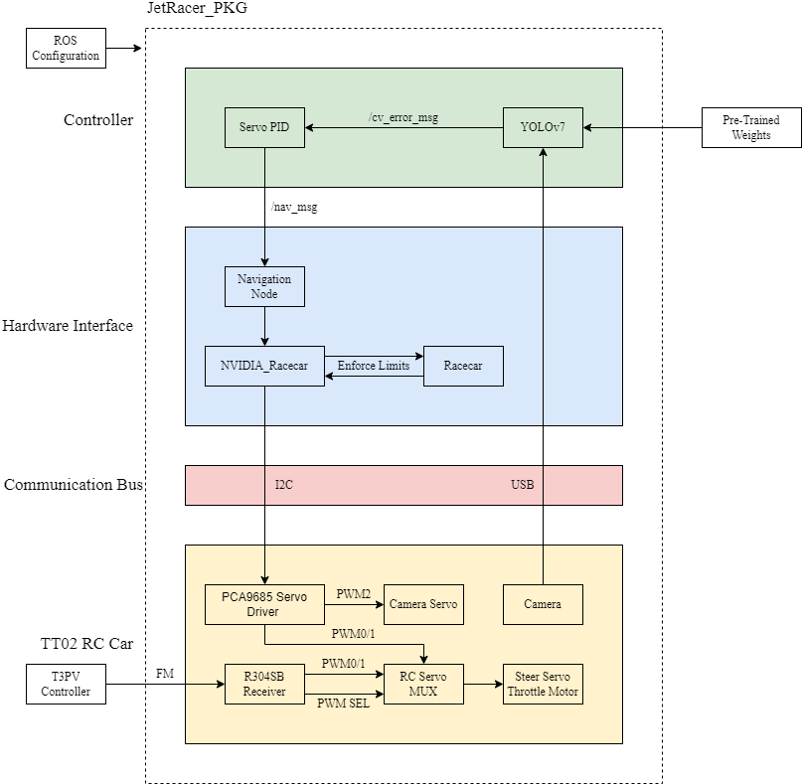
ROS
Setup ROS Melodic for hardware abstraction and streamline communication between processes
Created JetRacer package
Navigation node uses NVIDIA_Racecar and Racecar script for movement
Created keyboard tele-op node to test movement and camera swivel
Configured launch file for efficient startup
CV interpreter node uses camera bounding box error to control servo
Notes:
Cooper

Slide 15
Future ROS Work
Convert current ROS structure to ROS noetic
Implement ZED ROS integration
Further tune steering with CV
Implement on other cars
Update to Ubuntu 20.04
Notes:
Cooper

Slide 16
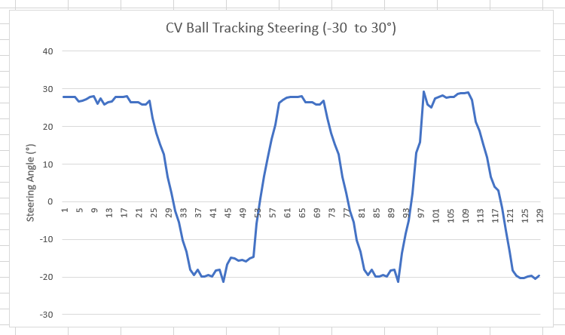
Ball Following
Converted location from CV to error from middle of the screen in pixels.
Wrote error output to text file.
Utilized ROS structure to update servo position from error when txt file was updated.
Notes:
Casey

Slide 17
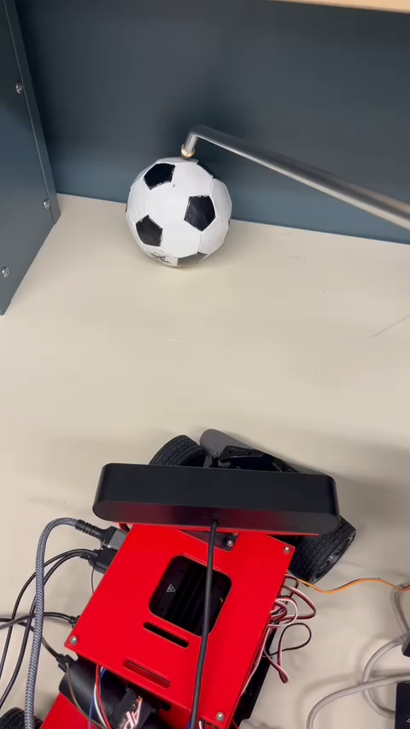
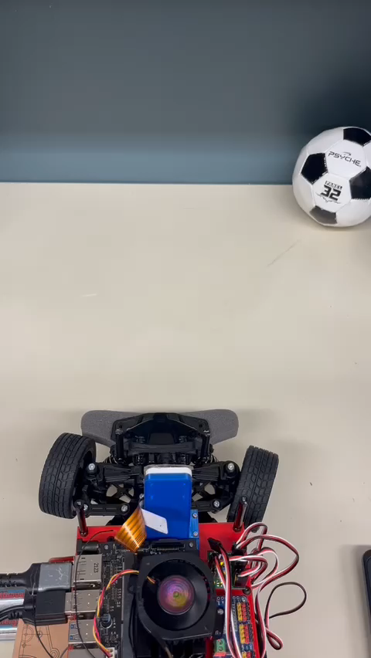
Demo/Results
ZED2 YOLOv8 ball following
YOLOv7 ball following
Notes:
Casey

Slide 18
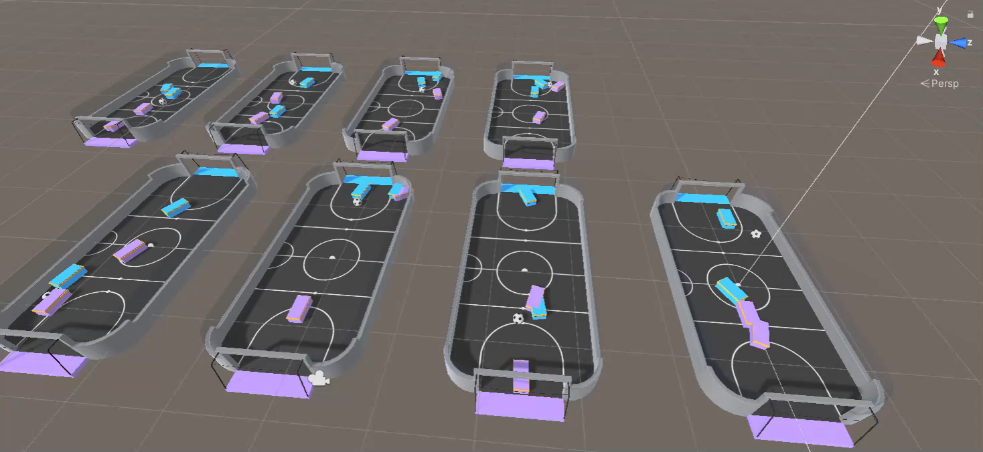
Unity
Initial attempts to reproduce the 2v2 simulations were hindered by corrupted files from last year's GitHub
Pivoted to using Unity's ML agent code, successfully running and training our agents in these scenarios, as shown here
Notes:
Mason

Slide 19
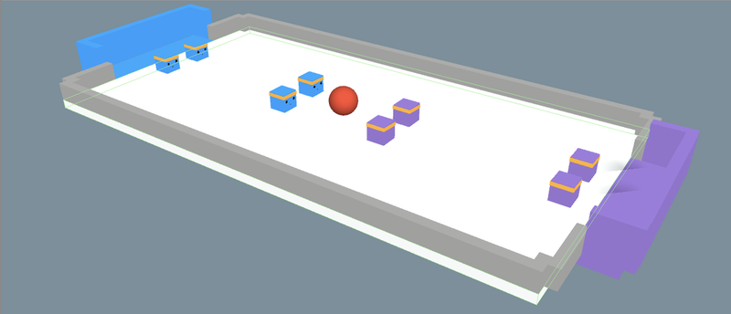
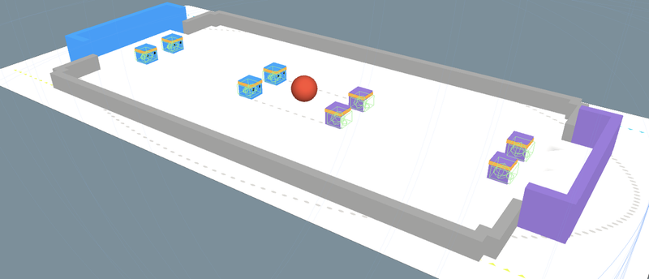
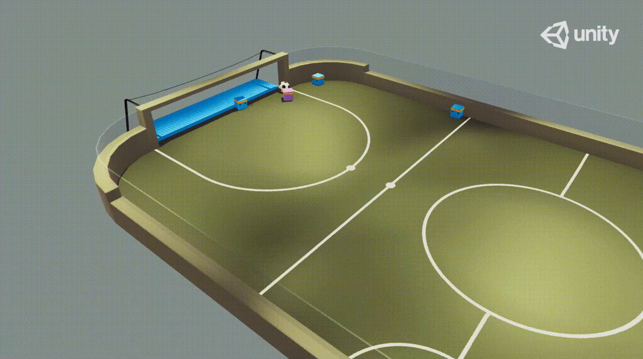
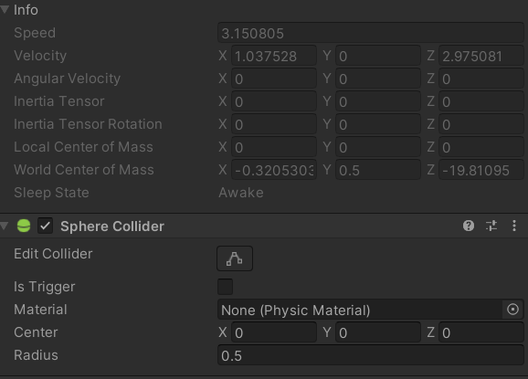
Unity
Designed a larger simulation with extra agents for better data, though real-life application would be 2v2.
Redesigned the field to match the dimensions of the field in real life.
However, the JetRacer cars are far less agile with a large turning radius
Adjusted their movement parameters, and no horizontal movements for them.
Notes:
Mason

Slide 20
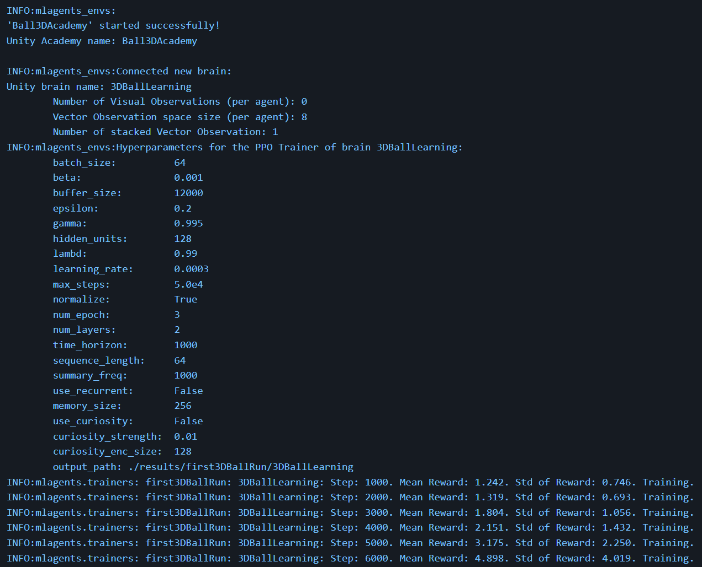
Unity
From the training fields, we can get the following data to potentially use on the cars IRL.
Future work: focused on creating a pipeline to integrate this data into actual cars for simulation-like movement.
Notes:
Mason

Slide 21
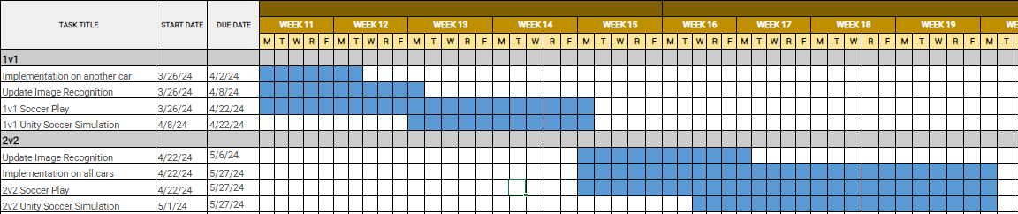
Gantt Chart for Spring Quarter
Goal for next quarter: Focus on improving image recognition, soccer strategy, and implementing the system onto more cars
Notes:
Julie

Slide 22
References
LIDAR: https://www.ydlidar.com/
ZED 2: https://www.stereolabs.com/products/zed-2
ROS Wiki: https://wiki.ros.org/ROS/Tutorials
JetRacer Soccer League Year 3 Github: https://github.com/Masonry11/JetRacer-Soccer-League-Year-3
JetRacer Soccer League Year 1 and Year 2 Github: https://github.com/JetRacer-Soccer-League
NVIDIA Jetson Nano: https://developer.nvidia.com/embedded/jetson-nano-developer-kit
Notes:
Jarod

Slide 23
Q&A
Thanks for listening! Feel free to ask any questions.
Notes:
Jarod

